Slide 1
Maths and Statistical Foundations for Analytics
Lecture 6: Confidence Interval

Slide 2
6.1 Estimating a Population Mean

Slide 3
Definition 6.1
Point Estimate
A point estimate of a parameter is the value of a statistic used to estimate the parameter.

Slide 4
Definition 6.2
Confidence-Interval Estimate
Confidence interval (C I): An interval of numbers obtained from a point estimate of a parameter.
Confidence level: The confidence we have that the parameter lies in the confidence interval (i.e., that the confidence interval contains the parameter).
Confidence-interval estimate: The confidence level and confidence interval.

Slide 5
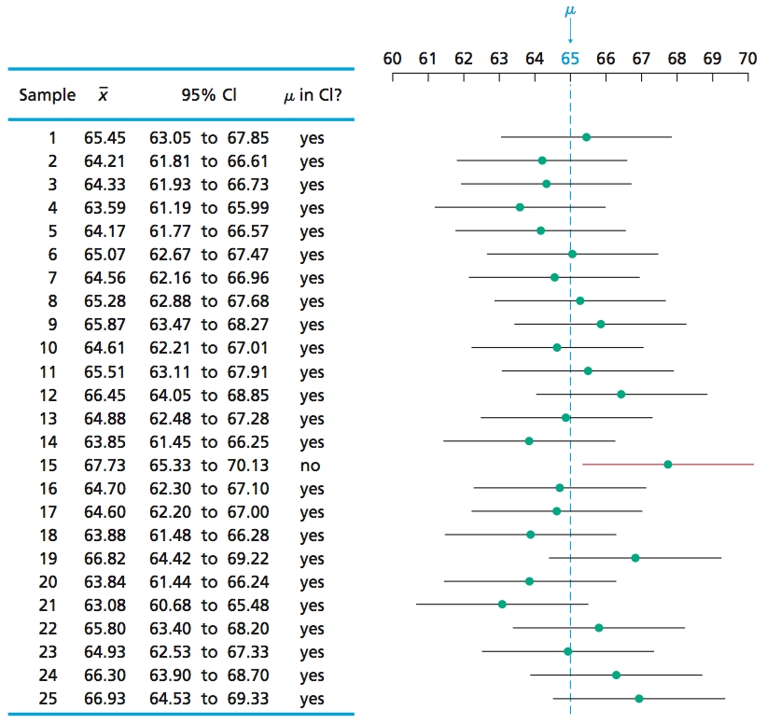
Figure 6-2
Twenty-five confidence intervals for the mean price of all new mobile homes, each based on a sample of 36 new mobile homes

Slide 6
6.2 Confidence Intervals for One Population Mean When σ Is Known

Slide 7
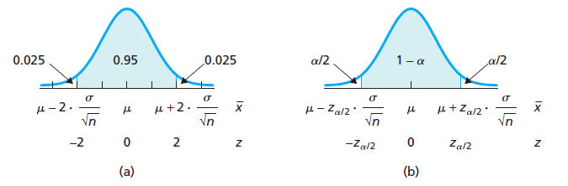
Figure 6-3
(a) Approximately 95% of all samples have means within 2 standard deviations of μ;
(b)
of all samples have means within
standard deviations of μ.

Slide 8
Procedure 6.1
One-Mean z- lnterval Procedure
Purpose To find a confidence interval for a population mean, μ
Assumptions
1. Simple random sample
2. Normal population or large sample
3. σ known
Step 1 For a confidence level of 1 − α, use Table II to find
Step 2 The confidence interval for μ is from
is found in Step 1, n is the sample size, and
is computed from the same data.
Step 3 Interpret the confidence interval.
Note: The confidence interval is exact for normal populations and is approximately correct for large samples from nonnormal populations.

Slide 9
Key Fact 6.1
When to Use the One-Mean z-Interval Procedure
For small samples - say, of size less than 15 - the z-interval procedure should be used only when the variable under consideration is normally distributed or very close to being so.
For samples of moderate size - say, between 15 and 30 - the z-interval procedure can be used unless the data contain outliers or the variable under consideration is far from being normally distributed.
For large samples - say, of size 30 or more - the z-interval procedure can be used essentially without restriction. However, if outliers are present and their removal is not justified, you should compare the confidence intervals obtained with and without the outliers to see what effect the outliers have. If the effect is substantial, use a different procedure or take another sample, if possible.
If outliers are present but their removal is justified and results in a data set for which the z-interval procedure is appropriate (as previously stated), the procedure can be used.

Slide 10
Key Fact 6.2
A Fundamental Principle of Data Analysis
Before performing a statistical-inference procedure, examine the sample data. If any of the conditions required for using the procedure appear to be violated, do not apply the procedure. Instead use a different, more appropriate procedure, if one exists.

Slide 11
Table 6-4
Ages, in years, of 50 randomly selected people in the civilian labor force
16 | 37 | 52 | 65 | 36
50 | 47 | 51 | 34 | 45
40 | 37 | 61 | 46 | 62
39 | 40 | 19 | 33 | 59
24 | 47 | 45 | 48 | 26
60 | 42 | 46 | 33 | 20
24 | 31 | 38 | 22 | 61
30 | 34 | 70 | 34 | 58
61 | 39 | 49 | 41 | 21
32 | 60 | 45 | 32 | 27

Slide 12
Formula 6.1
Margin of Error for the Estimate of μ
The margin of error for the estimate of μ is
which is denoted by the letter E. Thus,
See Fig. 7.5.

Slide 13
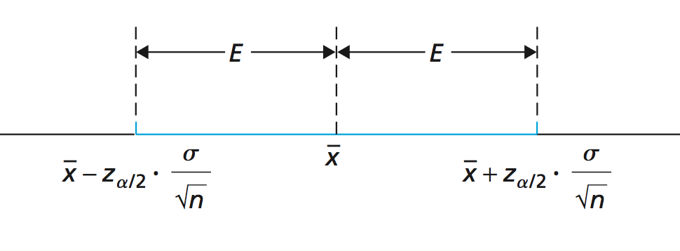
Figure 6-5
Margin of error, E

Slide 14
Key Fact 6.3
Confidence and Accuracy
For a fixed sample size, decreasing the confidence level decreases the margin of error and, hence, improves the accuracy of a confidence-interval estimate.

Slide 15
Key Fact 6.4
Sample Size and Accuracy
For a fixed confidence level, increasing the sample size decreases the margin of error and, hence, improves the accuracy of a confidence-interval estimate.

Slide 16
Formula 6.2
Sample Size for Estimating μ
The sample size required for a (1 − α)-level confidence interval for μ with a specified margin of error, E, is given by the formula
rounded up to the nearest whole number.

Slide 17
6.3 Confidence Intervals for One Population Mean When σ Is Unknown

Slide 18
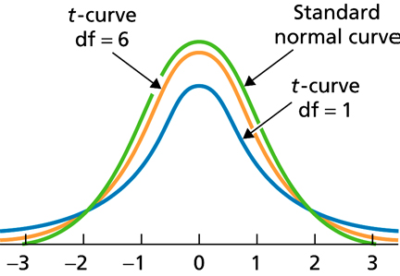
Figure 6-8
Standard normal curve and two t-curves

Slide 19
Key Fact 6.5
Studentized Version of the Sample Mean
Suppose that a variable x of a population is normally distributed with mean μ. Then, for samples of size n, the variable
has the t-distribution with n − 1 degrees of freedom.

Slide 20
Key Fact 6.6
Basic Properties of t-Curves
Property 1: The total area under a t-curve equals 1.
Property 2: A t-curve extends indefinitely in both directions, approaching, but never touching, the horizontal axis as it does so.
Property 3: A t-curve is symmetric about 0.
Property 4: As the number of degrees of freedom becomes larger, t-curves look increasingly like the standard normal curve.

Slide 21
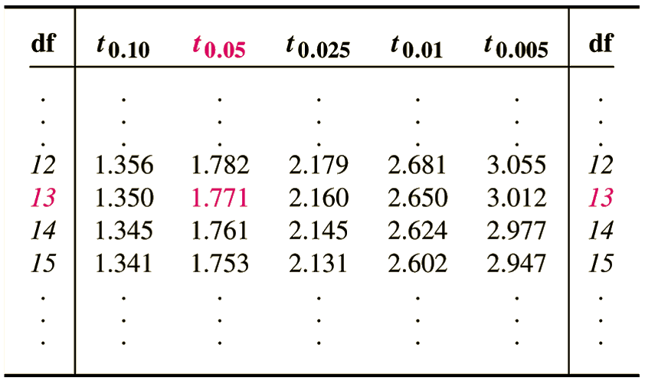
Table 6-5
Values of

Slide 22
Procedure 6.2
One-Mean t- lnterval Procedure
Purpose To find a confidence interval for a population mean, μ
Assumptions
1. Simple random sample
2. Normal population or large sample
3. σ unknown
Step 1 For a confidence level of 1 − α, use Table IV to find
With d f = n − 1,
where n is the sample size.
Step 2 The confidence interval for μ is from
is found in Step 1, and
and s are computed from the sample data.
Step 3 Interpret the confidence interval.
Note: The confidence interval is exact for normal populations and is approximately correct for large samples from nonnormal populations..

Slide 23
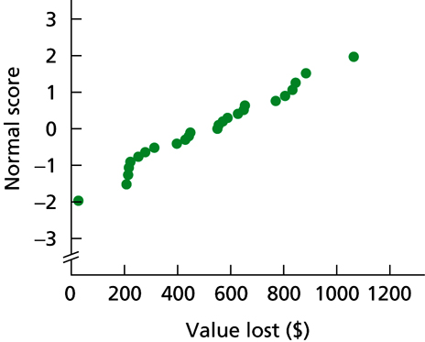
Table 6-6 & Figure 6-10
Losses ($) for a sample of 25 pickpocket offenses
Normal probability plot of the loss data in Table 8-5
447 | 207 | 627 | 430 | 883
313 | 844 | 253 | 397 | 274
217 | 768 | 1064 | 26 | 587
833 | 277 | 805 | 653 | 549
649 | 554 | 570 | 223 | 443

